Slide 1
Floor Tracer
Script for 3ds max

Slide 2
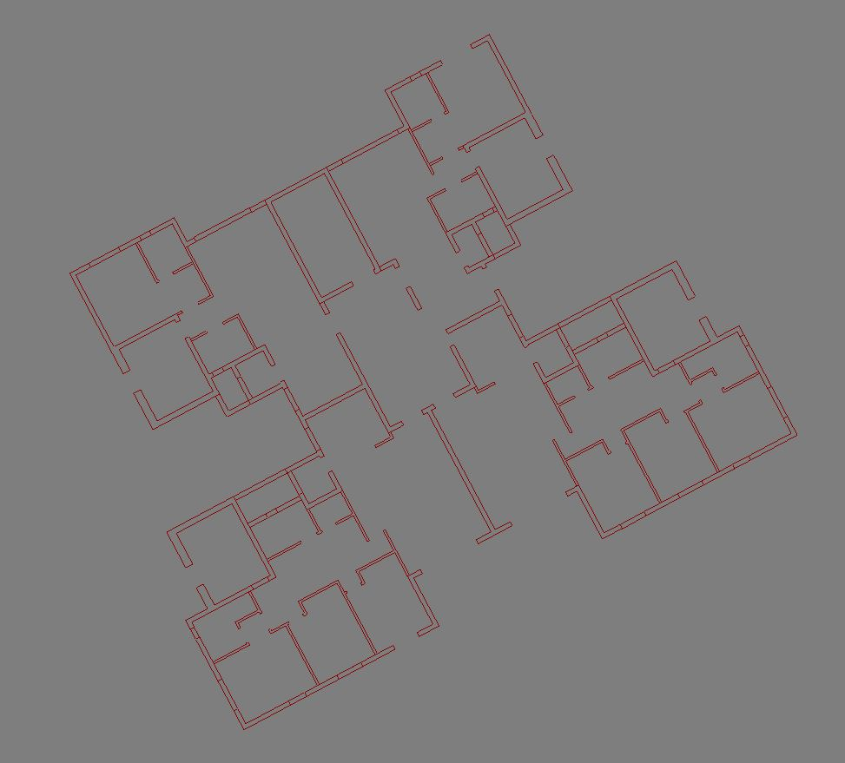
In 3D visualisation, clients provide drawings they’ve created as an architectural plan in mind.
Their drawings have, among other things, imprecisions, unclosed shapes, duplicate or overlapping lines, etc…
Those doesn’t matters to the architect.
For that reason, in order to create a 3d model and produce images correctly we have to draw them from scratch, using the architect’s drawing as a reference.
This script, generate correct shapes for walls, windows and doors openings, floors, and the whole floor contour, after correcting imprecisions.
The script is written in python 2.7 and the calculations are made without libraries.
The drawing on the left took 2 seconds with a pentium i5 3570 3.4 ghz and
4 gb ram

Slide 3
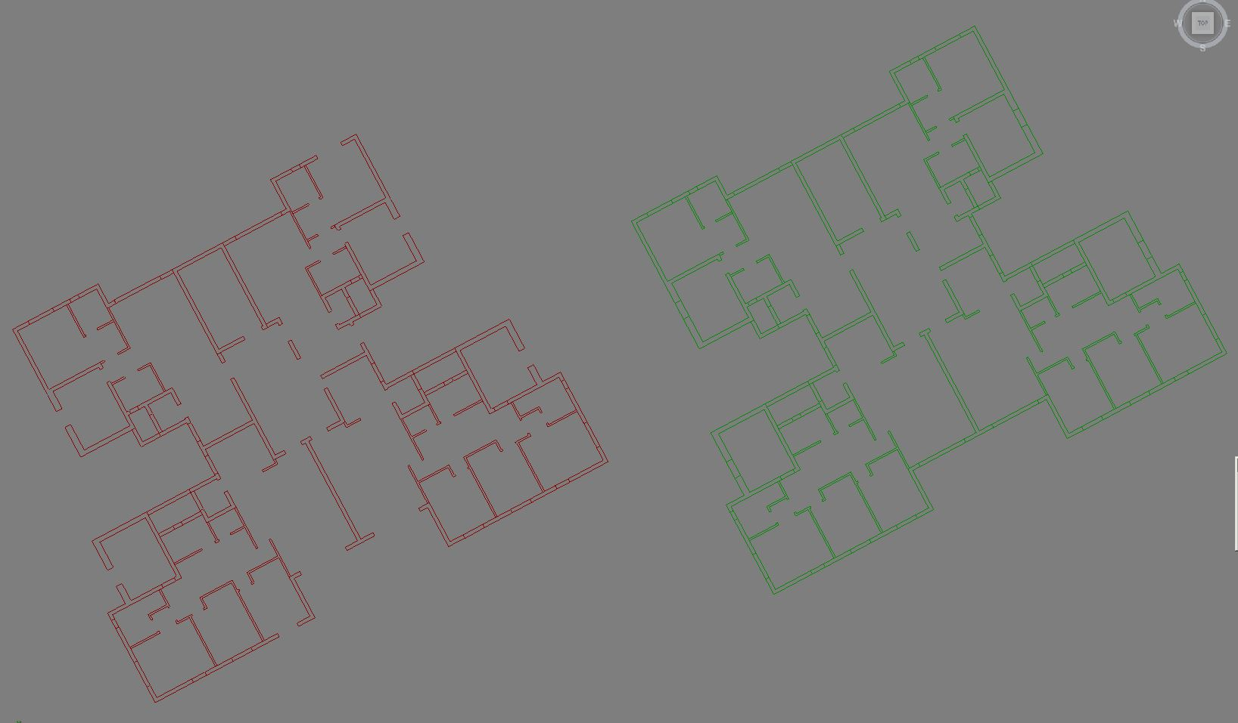
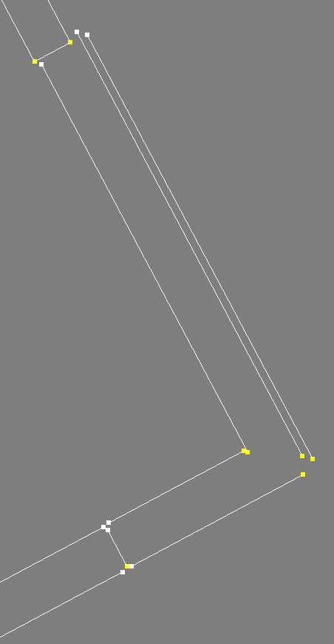
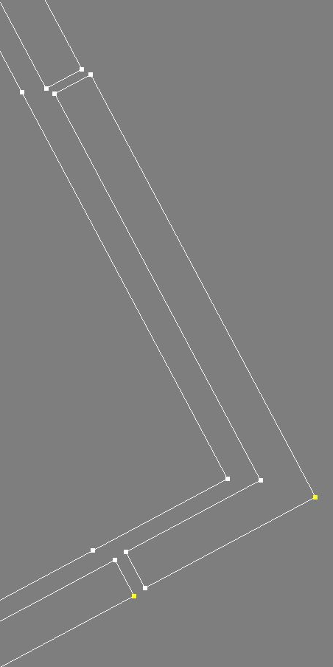
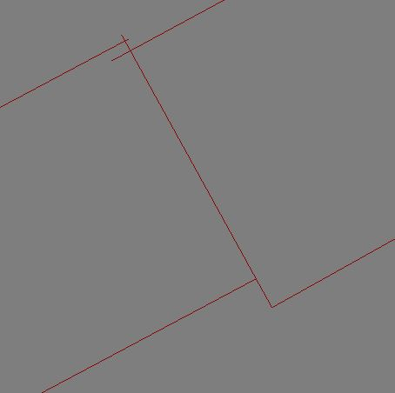
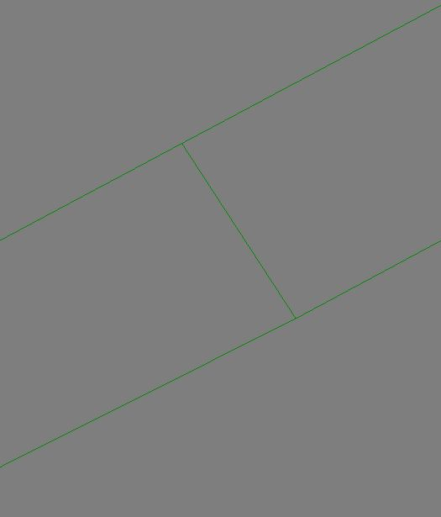
Examples:
Openings have been closed with new spline.
Related lines have been turned into geometric regions.
Imprecisions have been corrected.

Slide 4
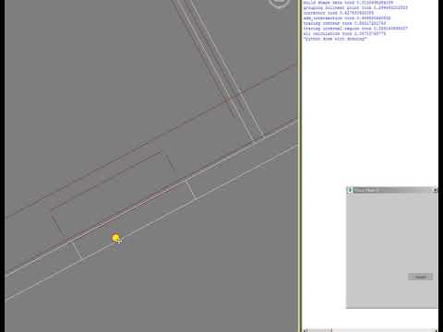
Demo video

Slide 5
current limitation:
- result are z planar
- curved spline are not supported,
also you can apply a normalize spline modifier or divide the curves.
- window, door and other symbol must be hidden,
splines will be created for windows / doors by guessing walls openings.
some parameters should be tweaked, among other max_wall_width, max_bridge_size (max opening width),...
the idea is to take it further, with an ui that wood allow to easily apply wall / window / door / floor preset
Floor Tracer is written for 3ds Max 2018
To launch the application:
Update path to reflect path to directory
3ds Max rollout \maxscript\floorTracer.ms

